Slide 1
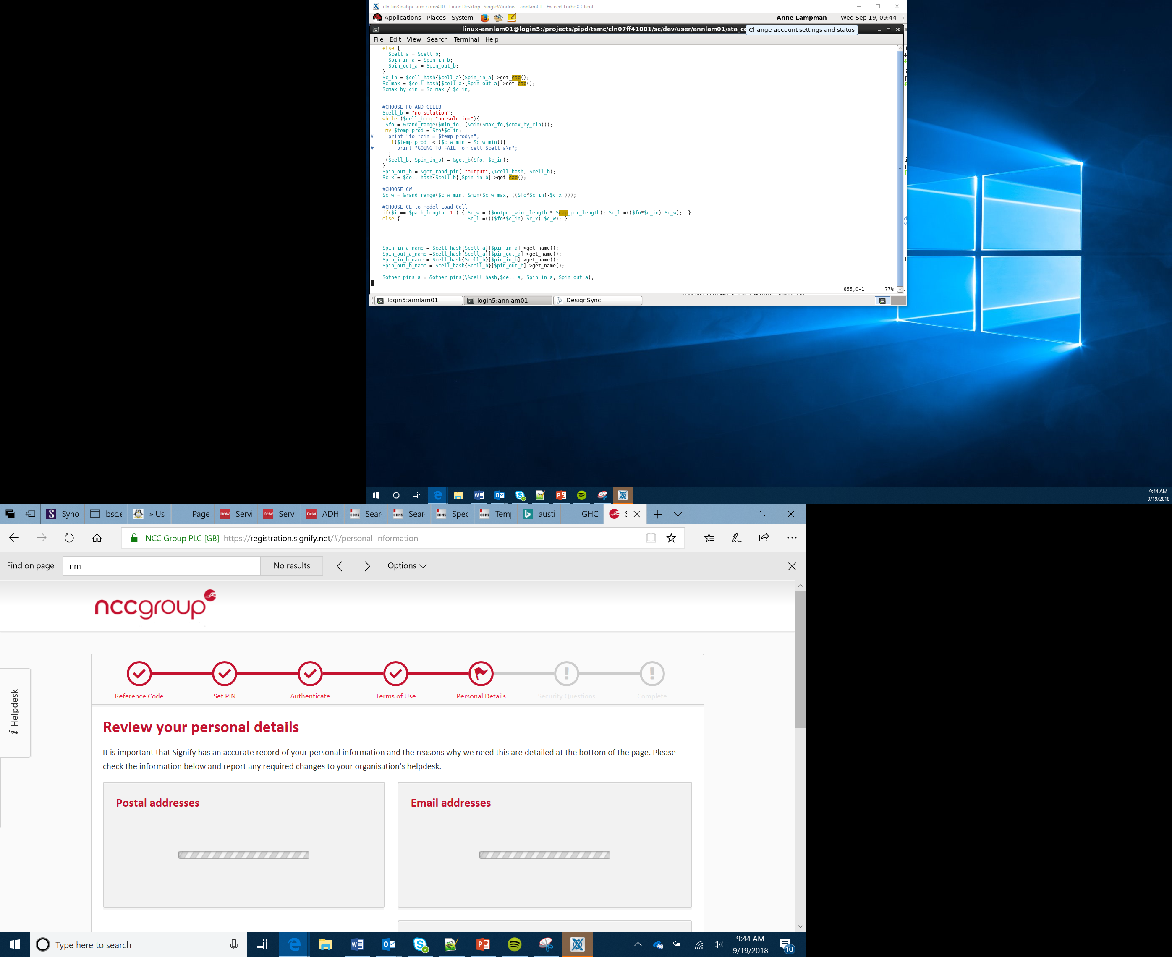

Smart Car
Part 1
Lesson 18

Slide 2
Objectives
To apply the skills and knowledge developed during the course to complete a team project
To perform a stakeholder analysis.
To complete a project SWOT analysis
Notes:
Introduce the objectives

Slide 3
Introduction
You and your team have been asked by ArmCars to design, develop and test a self-driving car
The car should be able to drive autonomously around the race track developed earlier
It should be able to stop at traffic signals and avoid collisions with pedestrians, road furniture and other vehicles
The primary goal is to get around the track safely without causing any damage to The Egg Family
The secondary goal is to do this in a ‘reasonable time’, but your family doesn’t choose their car on performance alone – style, safety and comfort all play a part
Notes:
Explain what the task will be – ensure Learners are aware that the key here is safety over speed.
Look at examples of common family cars, refer to features such as NCAP ratings.

Slide 4
Stakeholder Analysis
What is a stakeholder?
Any person with an interest or concern in something, especially a business
Who are the stakeholders for the new car?
Think Pair Share – In your teams identify the stakeholders and what their impact on or stake in the vehicles success is.
Stakeholder | Impact/Stake
Customers | If vehicle doesn’t meet their needs they won’t buy it.
Notes:
Discuss stakeholders with Learners.
Make sure Learners understand what a stakeholder is.
Look at it from manufacturing as well as the car retailers and the customers

Slide 5
Stakeholder Analysis
Market Research
Research current smart and driverless cars
Identify the group of people (market) you want to appeal too: Age, Gender, Socio-economic background
Identify what this group of people would want from their smart car
SWOT Analysis for you vehicle
Strengths
Weaknesses
Opportunities
Threats
Notes:
Get the Learners to do further research on driverless cars. Get them to try to identify the type of people (audience) of this type of cars. If it’s not ‘main stream’ how can they start to encourage main stream users
Discuss the purpose of a SWOT analysis and talk through each category – Use the template and example on Slide 6 to exemplify.

Slide 6
SWOT Analysis
Complete a SWOT analysis for your self-drive car
The example below will get you started
Strengths Do not need to know how to drive | Weaknesses Electric vehicles take time to charge
Opportunities Will reduce traffic jams | Threats People scared of ‘robot cars’

Slide 7
Informing Design Decisions
Evaluate the use of new technologies
Consider planned obsolescence
Ethics and environmental – end of working life disposal
Design for maintenance
Fashion and Trends
New Technologies
Through your market research, look at the latest technologies available and new materials that could be used weigh these up against the following criteria:
Cost
Reliability
Longevity
Sustainability
Recyclability
Notes:
Discuss the factors that inform design – get the student to think of examples where fashion has had a major impact on design decision (smartphones)
Look at new technologies that are being developed and new composite materials and discuss how these could be used or whether it is practical to use them

Slide 8
Informing Design Decisions
Planned Obsolescence
Consumers will expect our car to last a long time. Planned obsolescence is about ensuring the product will only function for a certain length of time. As designers and manufacturers we need to consider how long it will last
Appropriate Engineered Quality
As the vehicle needs to last a long time, we need to ensure appropriate materials are used that will survive all weather conditions and any potential accidents. We could utilise quick build techniques for cosmetic parts such as the body – eg vacuum forming or steel presses
Upgrading and Function
The core control unit (the micro:bit) could enable us to add or improve on functionality. Adding new features could encourage consumers who might not want to purchase a new vehicle to upgrade current models. Upgrades might only be available for a certain length of time – to link with the planned obsolescence and to encourage our customers to buy the latest model. Consider how Apple stop doing OS upgrades on old models or slow down older models over time to encourage purchase of a new iPhone
Notes:
Continue to discuss the different factors that inform the decision designer make

Slide 9
Informing Design Decisions
New Technologies
New materials and technologies may make models obsolete. Consumers will want the latest models using the latest technology. Consumers want the latest versions
Fashion and Trends
Some products or designs may be fashion led. It will become cool to own a driverless car in the beginning and we could ride this wave as part of the design. As self-driving cars become the norm we should continue to look at how we can take advantage of fashion and trends in our design, mirroring the latest styles or colour preferences in our models
Notes:
Continue to discuss the different factors that inform the decision designer make

Slide 10
Technology Life Cycle
New products follow a well defined life cycle:
1. Research and Development – high cost to us as we develop out new technology
2. Growth - Customers start to purchase and we start making money from a rise in sales
4. Decline – Market is saturated with models or another newer product has come to market – start R&D in next model
3. Maturity – The product becomes the norm, competition offer similar products fall in sales start
Notes:
Explain the Technology Life Cycle
Identify where we currently are on this cycle and what we need to do to move forward.

Slide 11
Technology Adoption Cycle
This can also work along side the Technology Adoption Cycle
Stage 1 Early Adopters
Stage 2 Early Majority
Stage 3 Late Majority
Stage 4 Laggards
The trend setters and tech followers that buy new technologies – mass media hype starts
The mainstream market starts to come onboard – often younger buyers open to new ideas
The rest of the majority, tend to be older, more conservative and less socially active
Very conservative, tend to be the oldest or least educated
Notes:
Ensure you discuss the Technology Adoption Cycle and again how are we going to move towards Stage 2

Slide 12
TAC and TLC
Think Pair Share
How will you get the early adopters on board quickly?
How can you encourage the early majority:
Advertising?
Branding
Fashion trends?
Would giving away models to trend setters, influencers and celebrities help encourage sales?
Notes:
What are the factors that will hold us back in the TLC and TAC?
How could Learners help to move their products forward?

